Slide 1
Pedestrian and Bike Plan
West St. Paul
Monday, December 13, 2021
Gaby Gutenkauf, Group Leader | Wyatt Schulman, Group Liaison Crosby Carreno | Elizabeth Grove | Sara Ostertag
Notes:
Introduce presenters

Slide 2
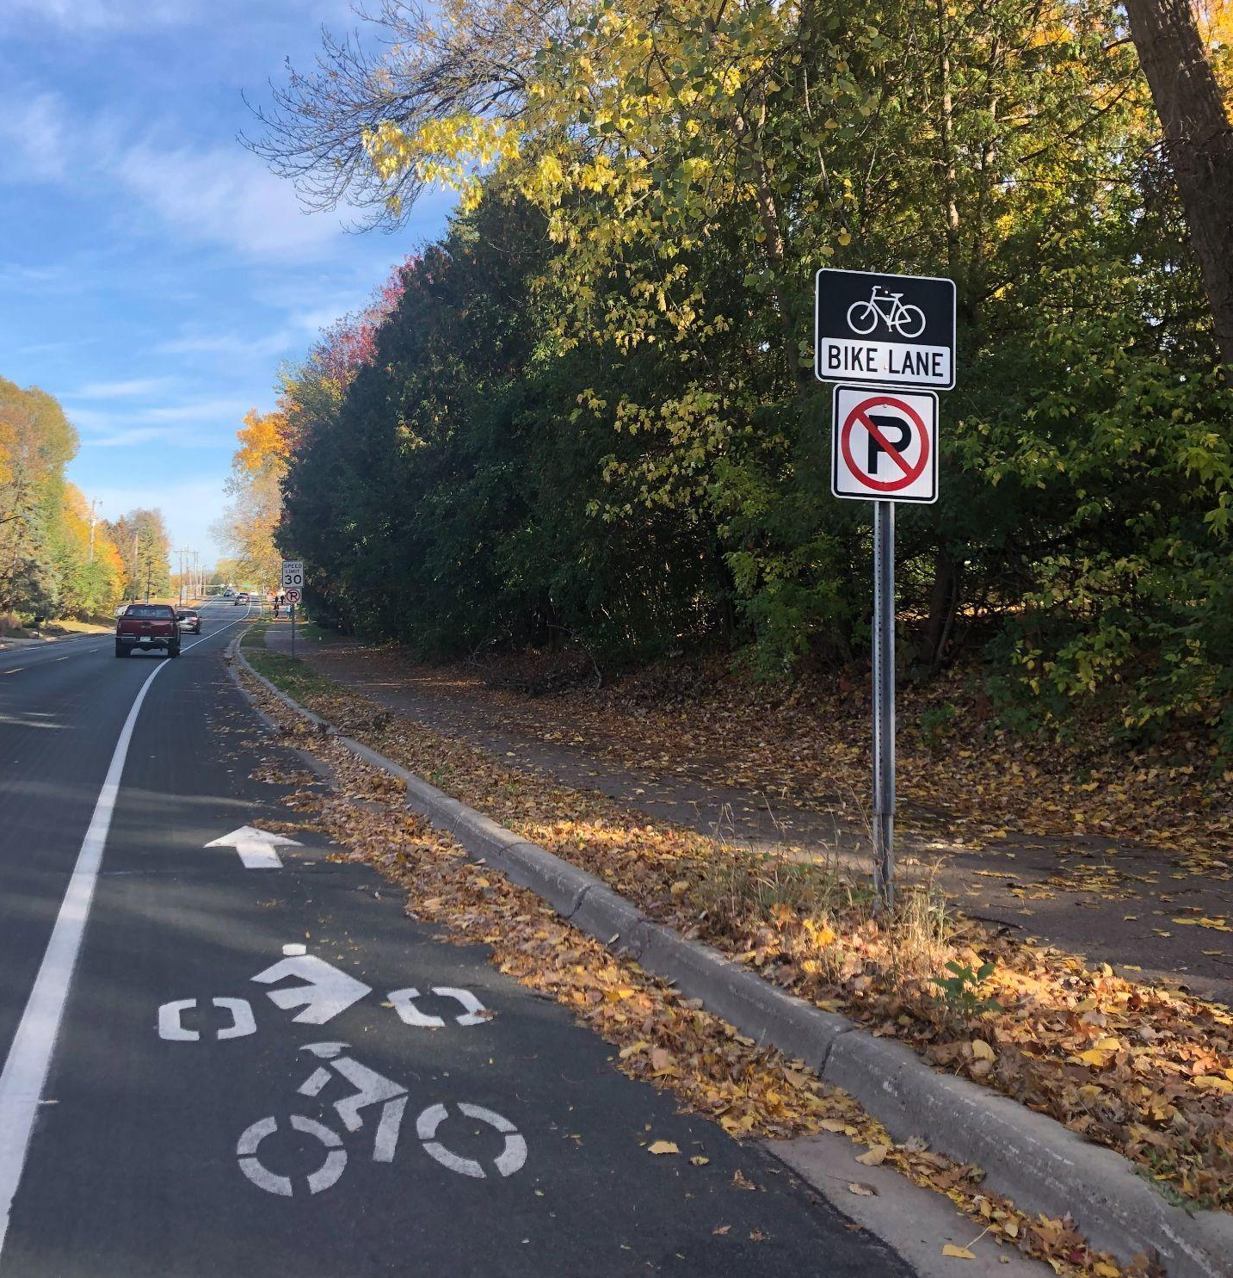
Methods and Findings
Observational Inventory
Equity Study
Comparative Analysis
Document Analysis
A bike lane on Marie St. in West St Paul
Photo Credit: Gaby Gutenkauf

Slide 3
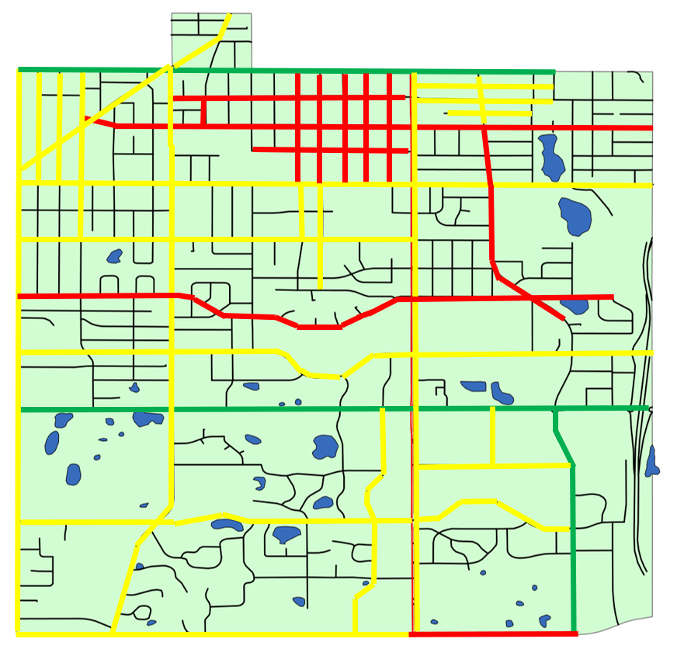
Progress Report
Legend:
Green- Complete
Yellow- Partial Completion
Red- Incomplete

Slide 4
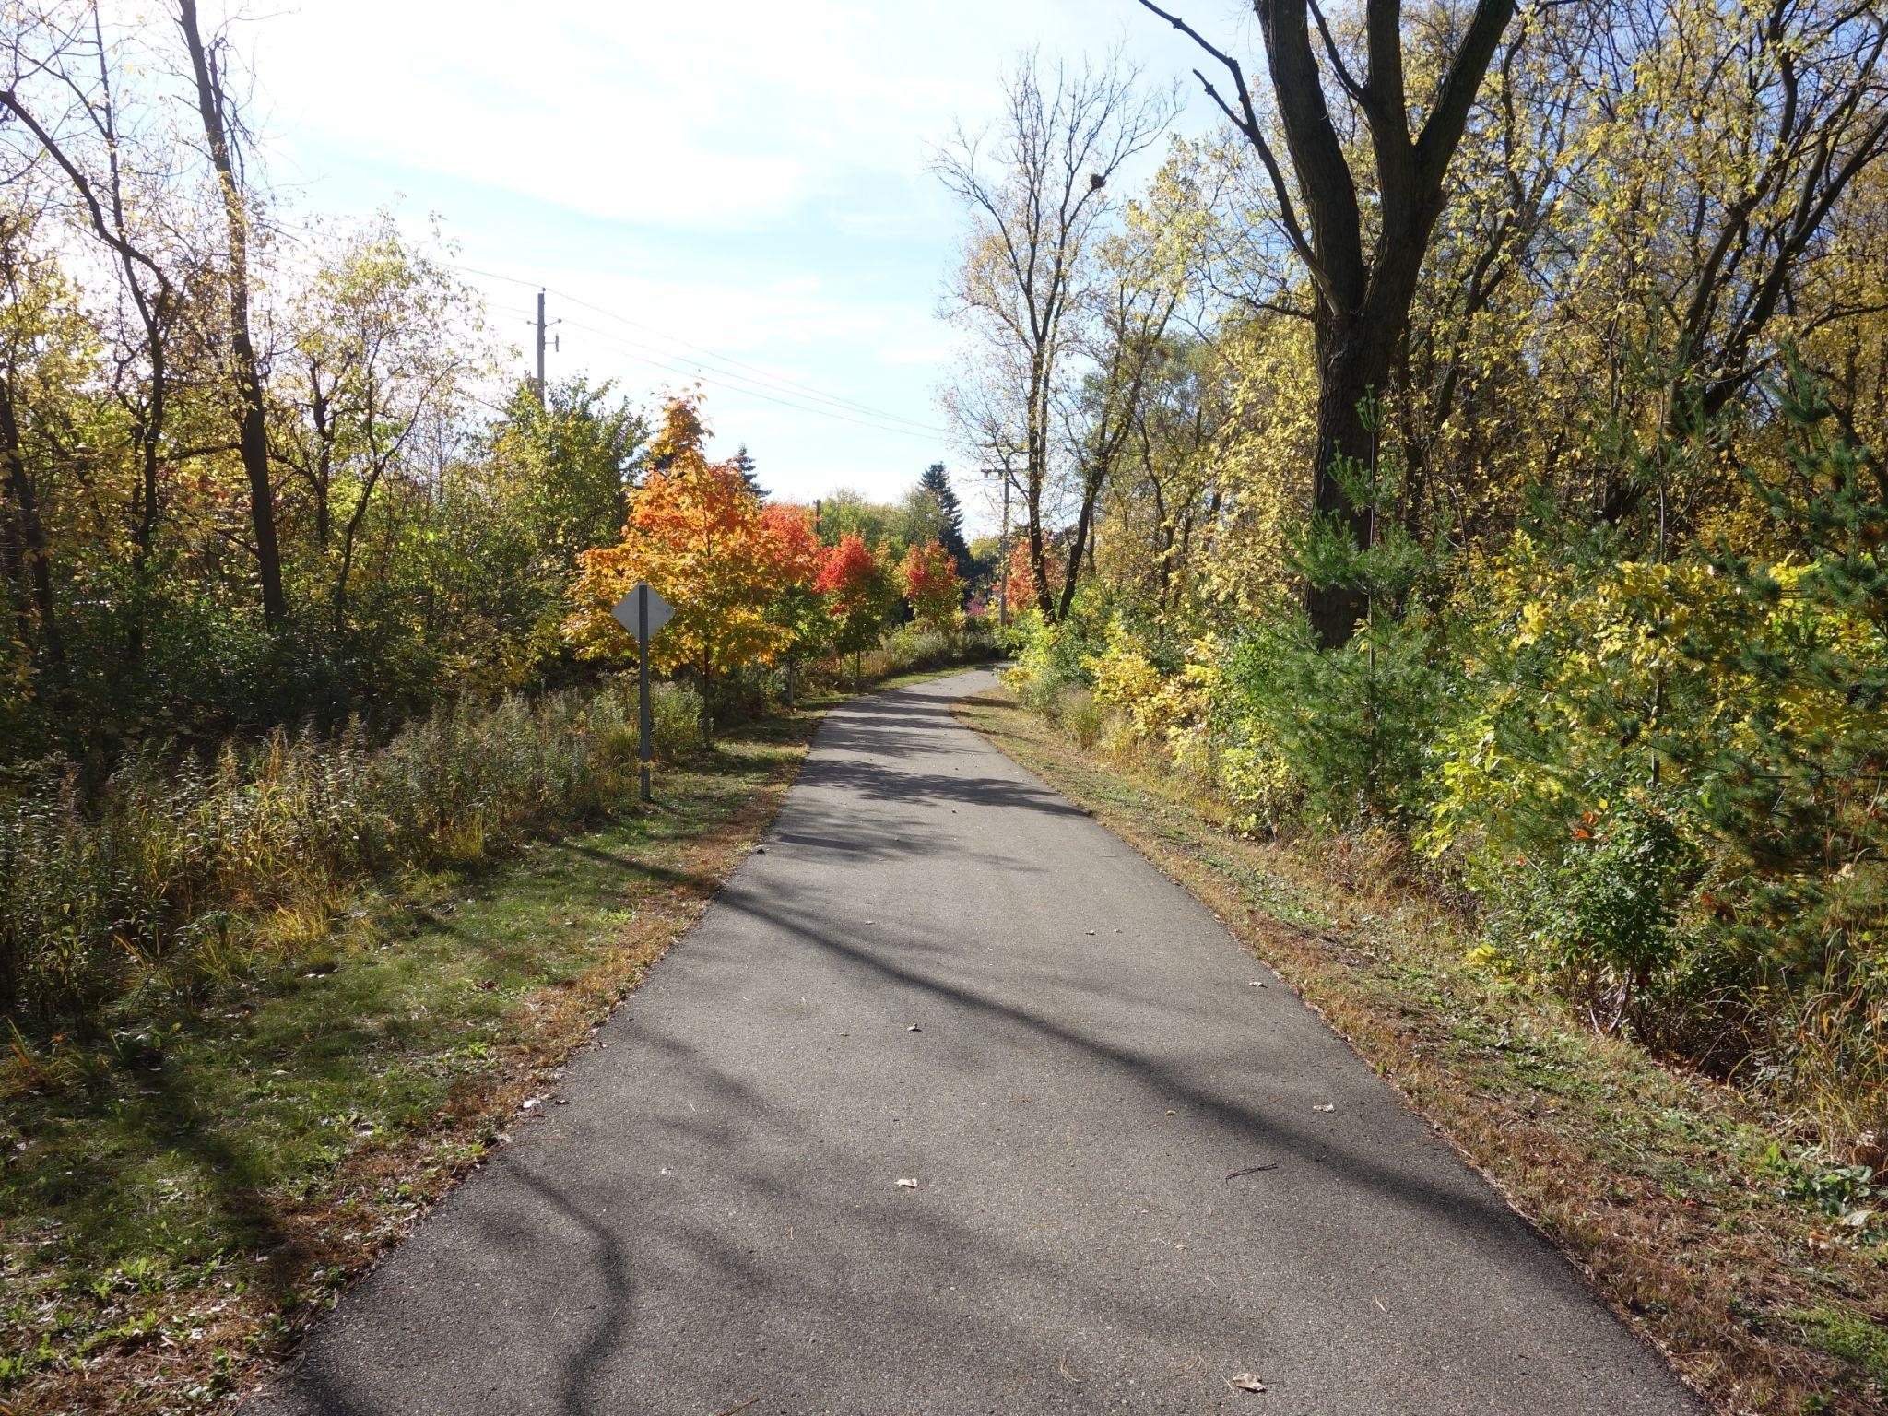
Recommendations
Increase signage
Re-evaluation of stakeholder involvement
Fully integrate the Complete Streets Policy into an updated Pedestrian and Bike plan
Bicycle Signage Examples
Photo Credit: Bicycle Alliance of Minnesota
North Urban Regional Trail near Dodge Nature Center
Photo Credit: Elizabeth Grove

Slide 5
Questions?
Next up, Park Use Assessment and Equity!

